Slide 1
Predictive Analysis on Credit Card Defaults Based on Demographic Factors and Payment Behavior
CIND 820 XJH W2024
Project by: Md Fahim Ferdous
ID: 501232653

Slide 2
Project Presentation Summary
Project Objective
Data Dictionary
Past Researches
Methodology
Exploratory data Analysis
Pearson Correlation
Correlation Heatmap
Model Approach
Model Execution
Model Cross Validation
Notes:
Slide description: Our New Chapter. In April 2022, the university announced our new name of Toronto Metropolitan University, which will be implemented in a phased approach. Learn more about our next chapter at torontomy.ca/next-chapter

Slide 3
Project Objective
The primary objectives for this project are:
Impact of Demographic factors and payment trend on Limit allocation
Conducting effective predictive analytics on card default based on impactful demographic factors and payment behavior
Broad Project Question
What is the quantified predictability of credit card default based on spending pattern, demographic behavior and limit allocation, which is evaluated by demographic and payment behavior pattern?

Slide 4
Data Dictionary
Attributes | Type | Maximum (if applicable) | Minimum (if applicable) | Mean | Standard Deviation
LIMIT_BAL | Quantitative | 1000000 | 10000 | 167484.32 | 129747.66
SEX | Categorical | 2 | 1 | NA | NA
EDUCATION | Categorical | 4 | 1 | NA | NA
MARRIAGE | Categorical | 3 | 1 | NA | NA
AGE | Quantitative | 79 | 21 | 35.49 | 9.22
PAY_0 TO PAY_6 | Categorical | 8.0 | -0.2911 to -0.0167 | -2.0 | 1.12 to 1.19
BILL_AMT1-BILL_AMT6 | Quantitative | 1664089 to 891586 | -170000 to -69777 | 51223.33 to 38871.76 | 73635.86 to 59554.11
PAY_AMT1 to PAY_AMT6 | Quantitative | 1684259 to 426529 | 0.0 | 4799.39 to 5921.16 | 23040.87 to 15278.31

Slide 5
Past Researches
The Role of the Credit Limit and Credibility (Soman and Cheema, 2002)- importance of credit limits in shaping spending behaviors, with consumers often using their assigned limit as an indicator of future earnings potential.
The Relationship between Demographic Factors and Financial Behavior on Credit Card Usage in Surabaya (Memarista, Malelak and Anastasia, 2015)-study with five demographic factors and tried to find out the relationship between financial behavior and demographic factors on credit card default.
The comparisons of data mining techniques for the predictive accuracy of probability of default of credit card clients (Yeh and Lien, 2009)-analysis to predict the card default based on six data mining techniques.

Slide 6
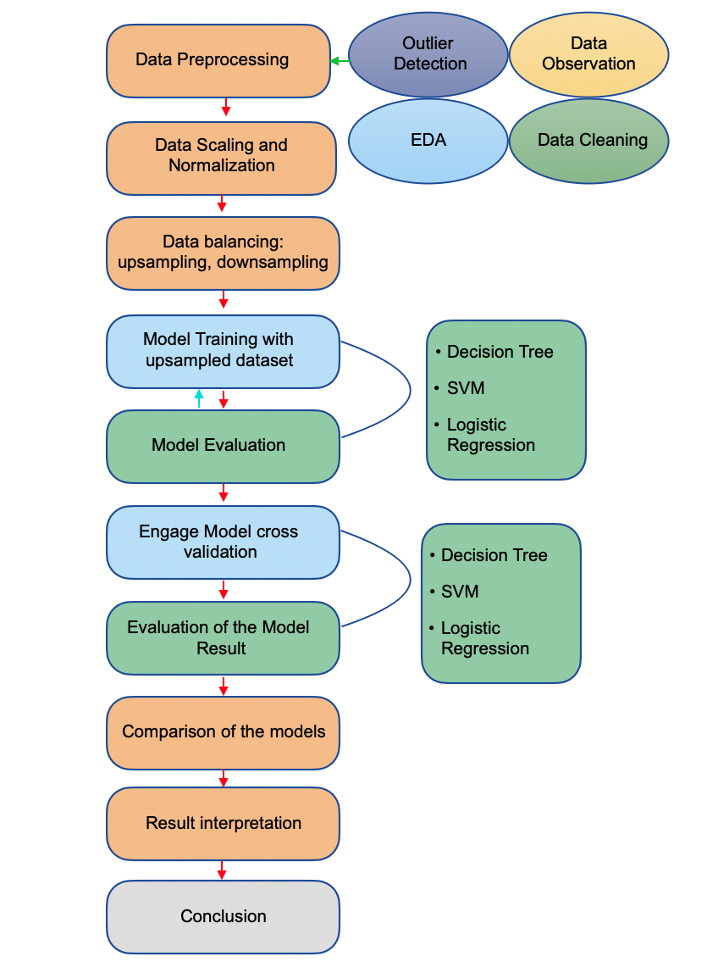
Methodology

Slide 7
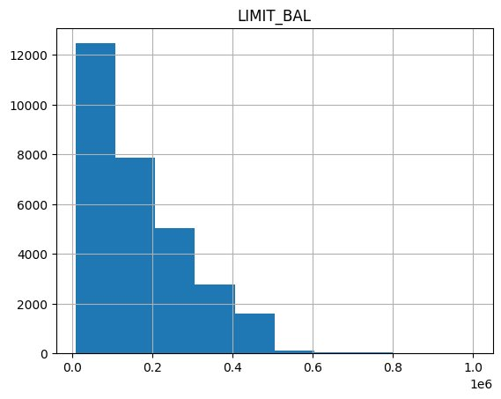
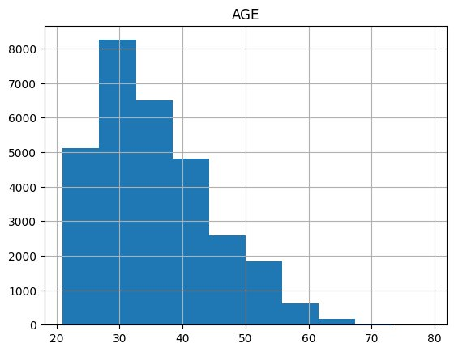
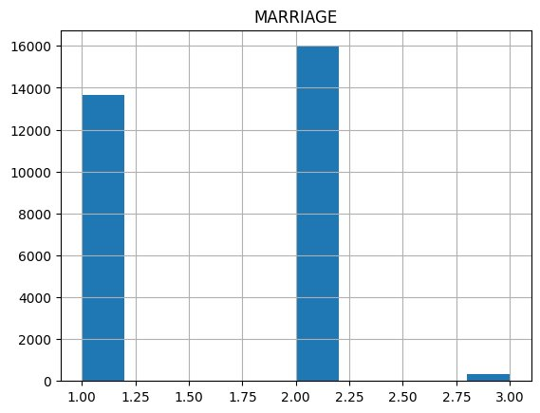
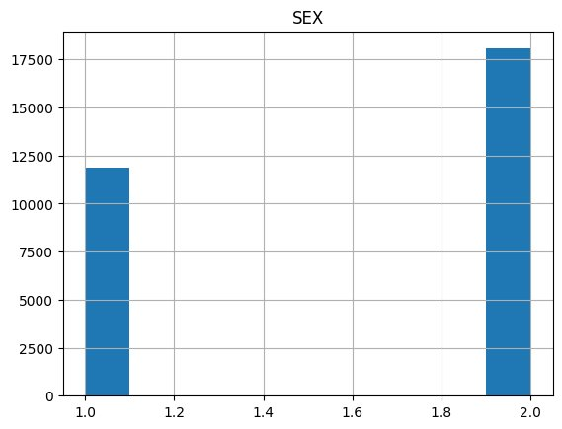
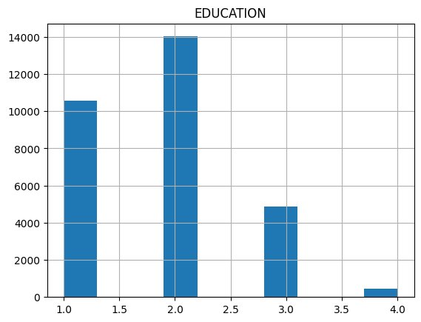
Exploratory Data Analysis

Slide 8
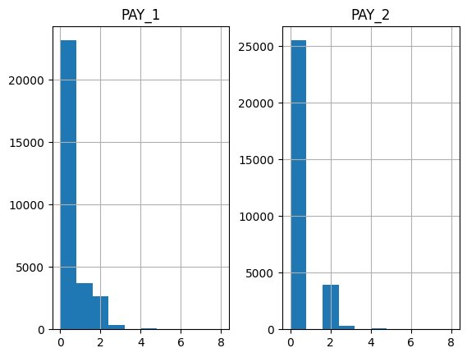
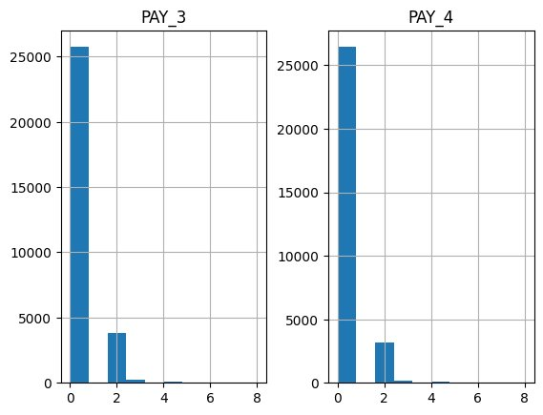
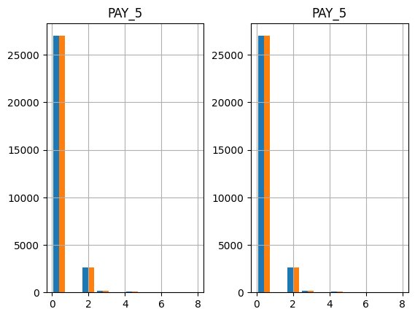
Exploratory Data Analysis

Slide 9
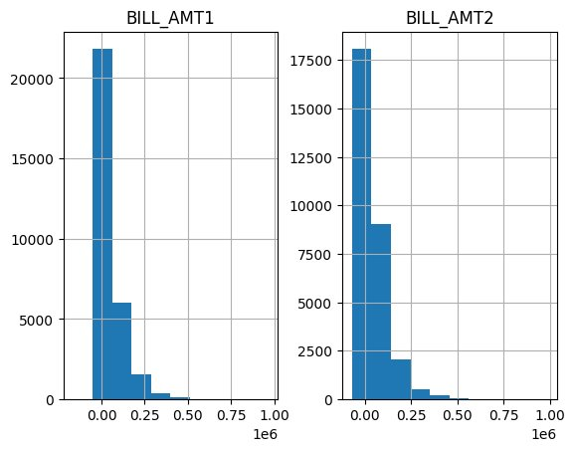
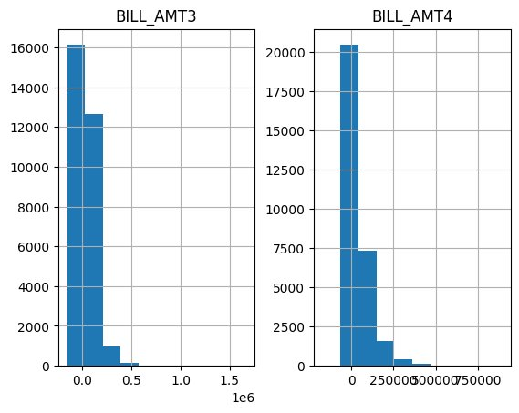
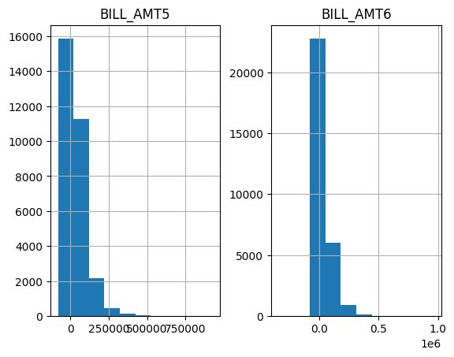
Exploratory Data Analysis

Slide 10
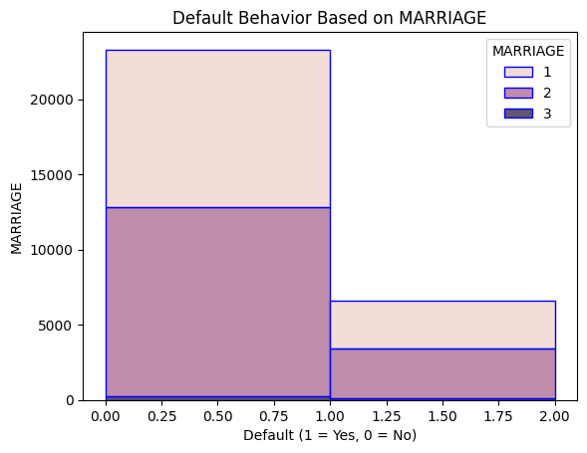
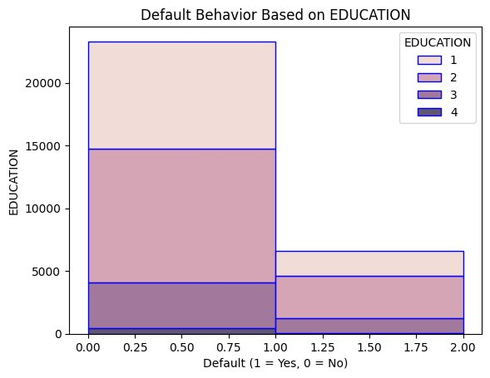
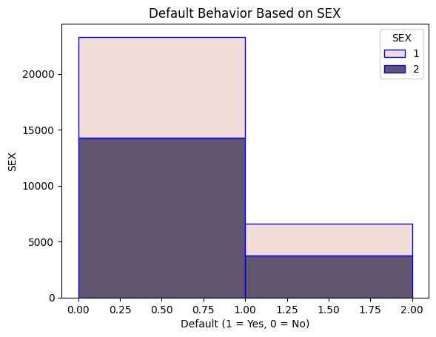
Exploratory Data Analysis
Default by MARRIAGE
 | 0=N | 1=Y
1 | 10,449 | 3,206
2 | 12,613 | 3,341
3 | 239 | 84
Default by EDUCATION
 | 0=N | 1=Y
1 | 8,545 | 2,036
2 | 10,695 | 3,329
3 | 3,640 | 1,233
4 | 421 | 33
Default by SEX
 | 0=N | 1=Y
1 | 8,995 | 2,871
2 | 14,306 | 3,760

Slide 11
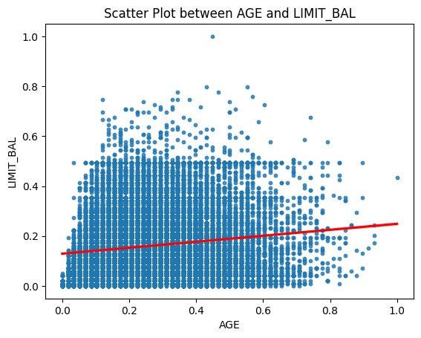
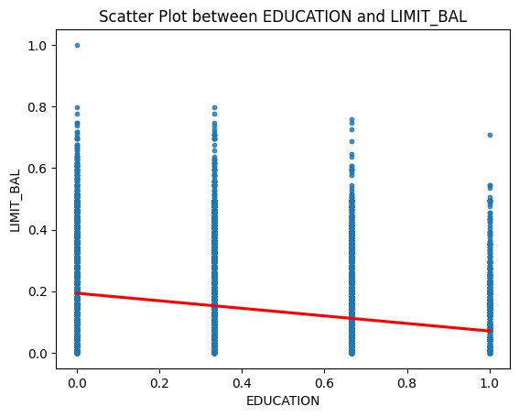
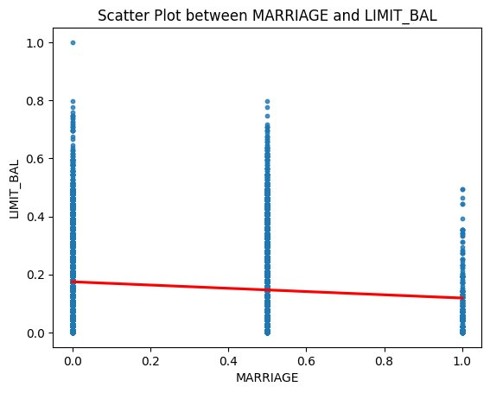
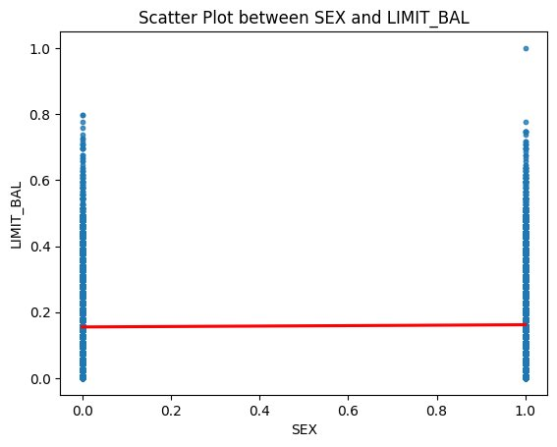
Pearson Correlation
 | LIMIT_BAL
 | Coefficient | +/-
AGE | 0.14 | +ve
EDUCATION | -0.23 | -ve
MARRIAGE | -0.11 | -ve
SEX | 0.024 | +ve

Slide 12
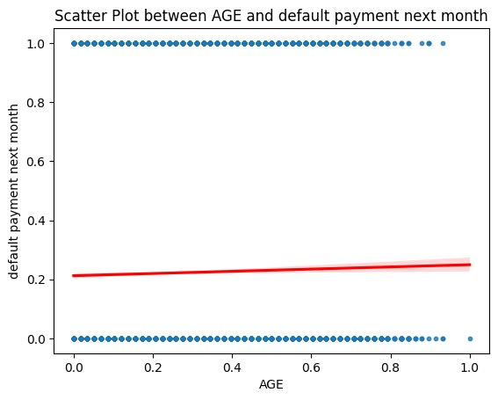
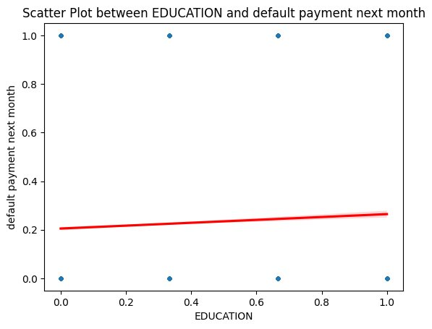
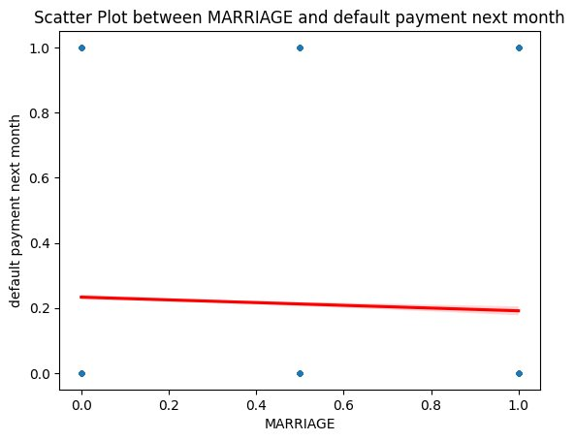
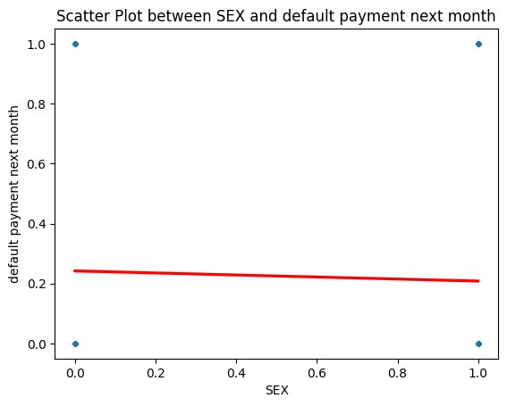
Pearson Correlation
 | default payment next month
 | Coefficient | +/-
AGE | 0.014 | +ve
EDUCATION | 0.035 | +ve
MARRIAGE | -0.026 | -ve
SEX | -0.039 | -ve

Slide 13
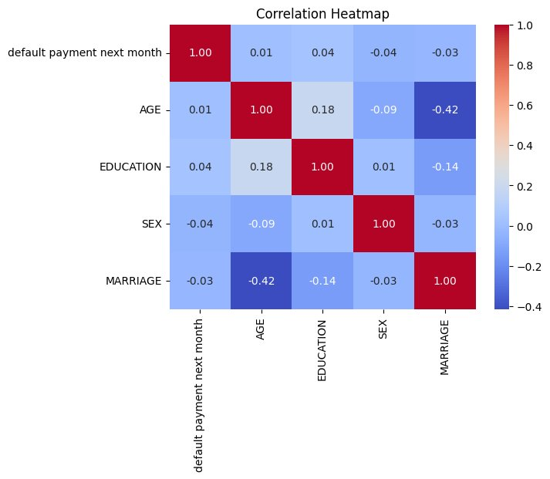
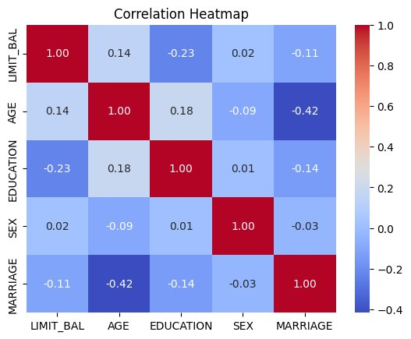
Correlation Heatmap
Correlation among the features are low
AGE has the strongest (positive) correlation with LIMIT_BAL
SEX has the lowest correlation with LIMIT_BAL
Correlation among the features are lower than LIMIT_BAL

Slide 14
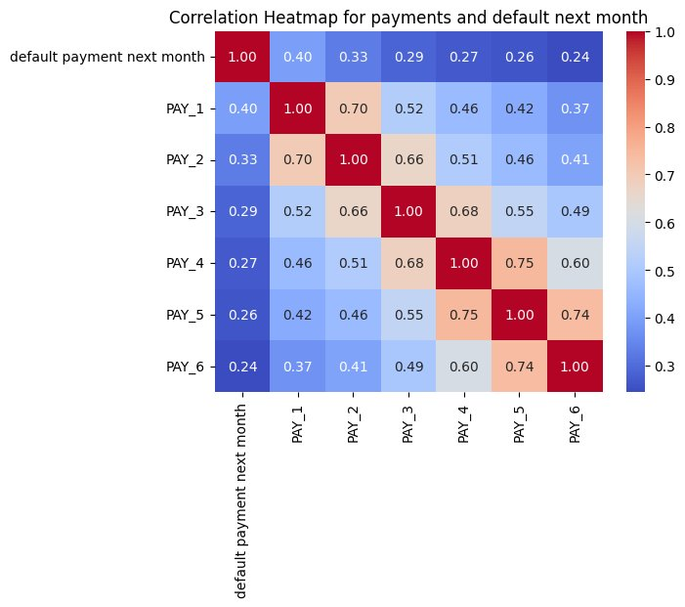
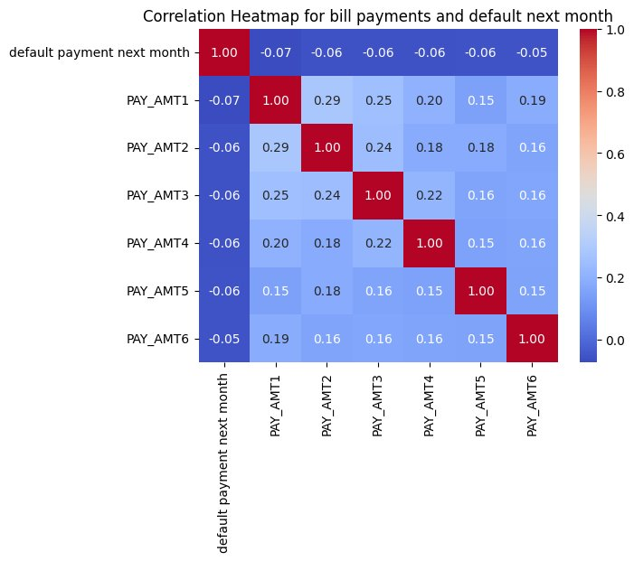
Correlation Heatmap
Low correlation with PAY features with default payment next month
The relation between PAY_AMT and default payment next month is even lower.
Inter variable correlation is comparatively high

Slide 15
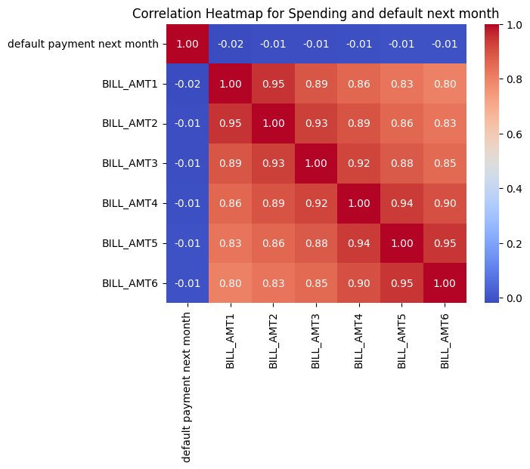
Correlation Heatmap
Independent feature correlation is very high
Multi-collinearity exists
Correlation between dependent variable and independent variable is low and negative.

Slide 16
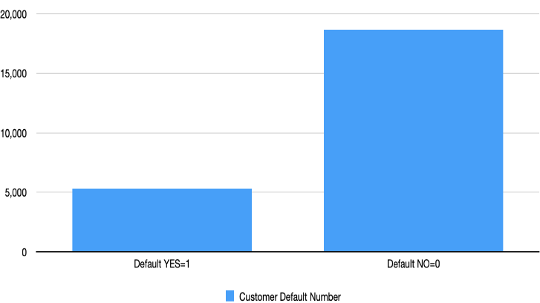
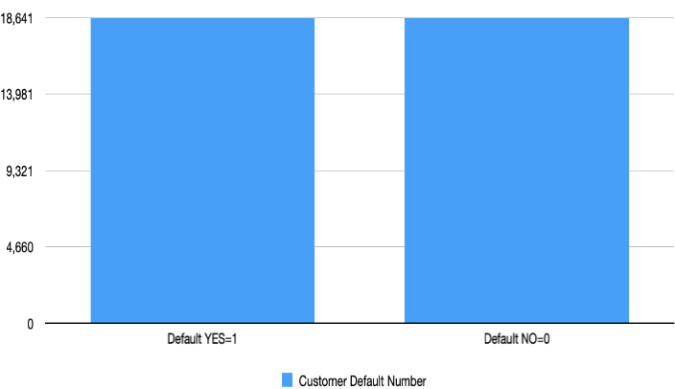
Model Approach
Current unbalanced data: Default Ratio 22.15%
Up-sampled data
Default Status | Current data | Up-sampled data | Down-sampled data
0=NO | 18641 | 18641 | 5304
1=YES | 5304 | 18641 | 5304

Slide 17
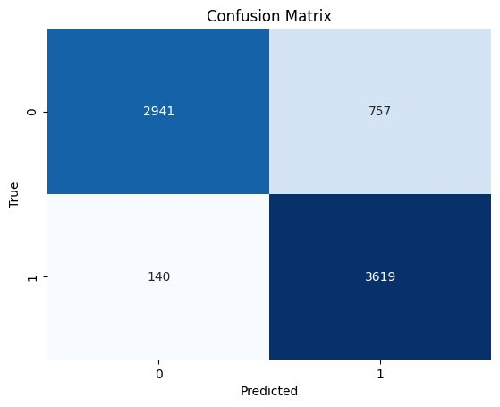
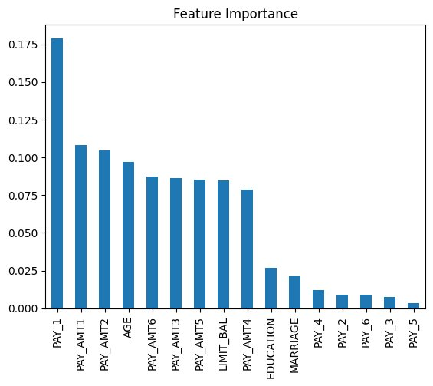
Model: Up-Sampled Decision Tree
 | Accuracy | Precision | Recall | F1 Score
Performance metrics | 87.97% | 82.70% | 96.28% | 88.97%

Slide 18
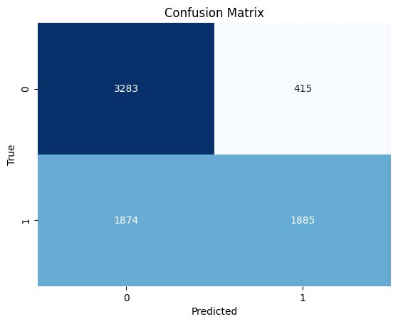
Model: Up-Sampled SVM
 | Accuracy | Precision | Recall | F1 Score
Performance metrics | 69.30% | 81.96% | 50.15% | 62.22%

Slide 19
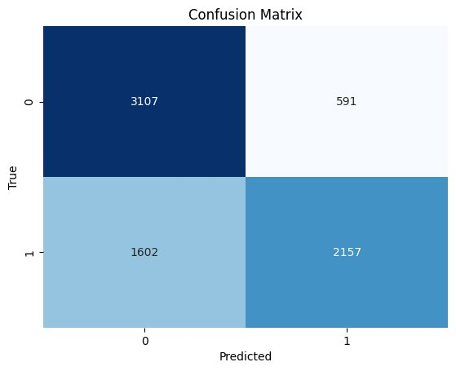
Model: Up-Sampled Logistic Regression
 | Accuracy | Precision | Recall | F1 Score
Performance metrics | 70.59% | 78.49% | 57.38% | 66.29%

Slide 20
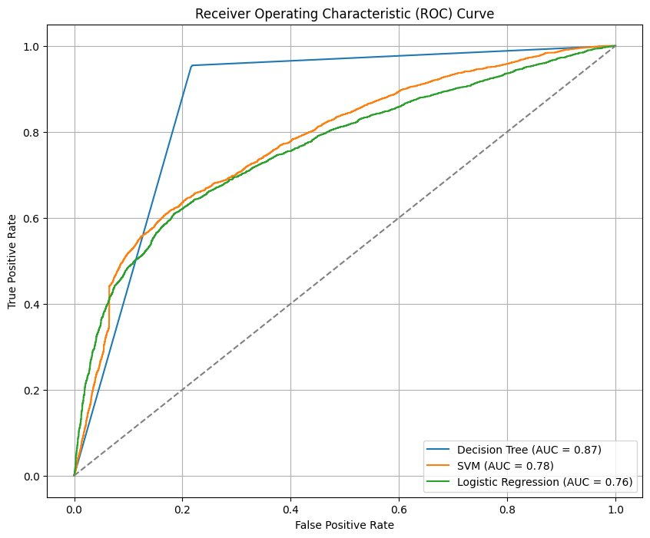
Model Performance Comparison
Metrics | Decision Tree | SVM | Logistic Regression
Accuracy | 87.97 | 69.30 | 70.59
Precision | 82.70 | 81.96 | 78.49
Recall | 96.28 | 50.15 | 57.38
F1 Score | 88.97 | 62.22 | 66.29

Slide 21
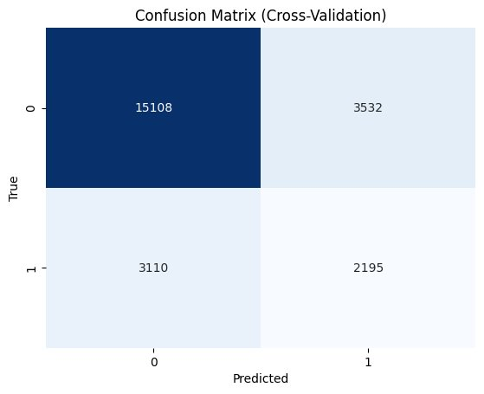
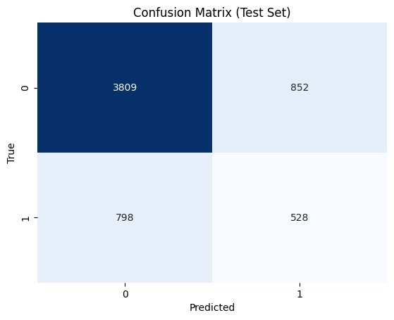
Model: Stratified K Fold Cross validation- Decision Tree
Training Set
Test Set
Performance metrics | Accuracy | Precision | Recall | F1 Score
Training Set | 72.26% | 38.33% | 41.38% | 39.79%
Test Set | 72.44% | 38.26% | 39.82% | 39.02%

Slide 22
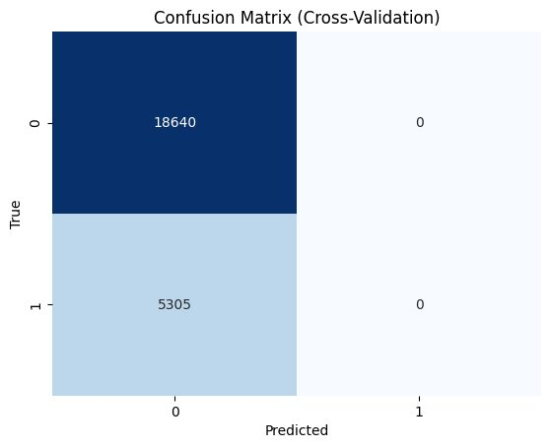

Model: Stratified K Fold Cross validation-SVM
Training Set
Test Set
Performance metrics | Accuracy | Precision | Recall | F1 Score
Training Set | 77.85% | 0.00% | 0.00% | 0.00%
Test Set | 77.85% | 0.00% | 0.00% | 0.00%

Slide 23
Model: Stratified K Fold Cross validation- Logistic Regression
Training Set
Test Set
Performance metrics | Accuracy | Precision | Recall | F1 Score
Training Set | 77.85% | 0.00% | 0.00% | 0.00%
Test Set | 77.85% | 0.00% | 0.00% | 0.00%

Slide 24
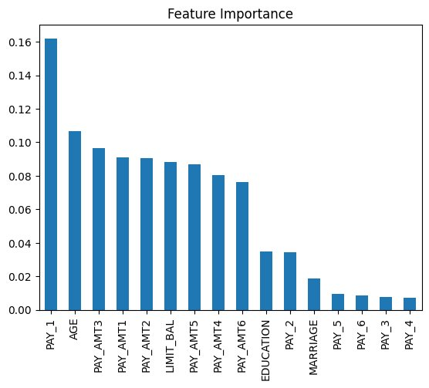
Result Decision: Decision Tree
Up-sampled Model
Stratified K fold CV Model
Pay_1 is the most important feature.
AGE is the most important demographic feature, after AGE, EUCATION and MARRIAGE has importance
PAY_AMT is important to determine credit card default
PAY features are not very important to determine default payment next month

Slide 25
Conducting Stratified K fold With Normalized Data
Training Set | Decision Tree | SVM | Logistic Regression
Accuracy | 72.24% | 82.05% | 81.74%
Precision | 38.31% | 68.00% | 68.65%
Recall | 41.41% | 35.85% | 32.33%
F1 Score | 39.80% | 46.95% | 43.96%
Test Set | Decision Tree | SVM | Logistic Regression
Accuracy | 72.47% | 81.46% | 81.29%
Precision | 38.33% | 65.84% | 67.88%
Recall | 39.89% | 33.86% | 29.49%
F1 Score | 39.10% | 44.72% | 41.11%
Support Vector Machine Appeared to be the most efficient model algorithm with normalized data

Slide 26
Output Implication and Past Research Match
The study explores the relationship between demographic factors, spending behaviors, and credit default rates, emphasizing the significance of age, education, and payment behavior.
Existing research highlights the importance of credit limits in shaping spending behaviors and the impact of demographic characteristics on credit defaults.
This study differs from previous research by analyzing the nuanced relationship between demographic factors, spending behaviors, credit limits, and credit defaults.
While previous studies have identified predictors of credit default, this study provides a deeper analysis of how demographic factors and spending behaviors interact to influence credit limits and defaults.
Contrary to some previous studies, the results show that credit default next month is heavily dependent on financial capabilities, with payment amount against the bill and first outstanding pay being crucial predictors. Age and education emerge as the most impactful demographic factors.

Slide 27
Recommendation for Future Research
Working with larger dataset for more conclusive result
Having more economic features to identify the impact on default.
This project worked with only three model algorithms, other model algorithms (i.e: KNN, Naieve Bayes etc.) should be conducted for better result.
Although cross validation is more robust, future works can consider hyper parameter tuning to find optimal features.
More financial features need to be added to justify the demographic factor impact

Slide 28
This project delves into the relationship between demographic factors, payment behavior, credit limit allocation, and credit card default rates. Financial indicators, particularly credit limit, play a significant role, along with demographic variables like AGE and EDUCATION. Decision Tree emerged as the most effective model, highlighting the importance of payment behavior in predicting defaults. However, SVM and Logistic Regression struggled with positive instances classification. With normalized dataset it is seen that SVM is the most efficient model. Despite limitations like dataset confinement and class imbalance, the study underscores the importance of these factors in predicting credit defaults. Future research should explore additional algorithms and datasets to enhance model robustness and generalization capabilities.
Concluding Statement

Slide 29
Reference
Achsan, W., Achsani, N. A., & Bandono, B. (2022). The demographic and behavior determinant of credit card default in Indonesia. Signifikan: Jurnal Ilmu Ekonomi, 11(1), 43–56. https://doi.org/10.15408/sjie.v11i1.20215
Çallı, B. A., & Coşkun, E. (2021). A longitudinal systematic review of Credit Risk Assessment and credit default predictors. SAGE Open, 11(4), 215824402110613. https://doi.org/10.1177/21582440211061333
GeeksforGeeks. (2023, June 10). Support Vector Machine (SVM) algorithm. GeeksforGeeks. https://www.geeksforgeeks.org/support-vector-machine-algorithm/
Goel, A., & Rastogi, S. (2021). Understanding the impact of borrowers’ behavioral and psychological traits on credit default: Review and Conceptual Model. Review of Behavioral Finance, 15(2), 205–223. https://doi.org/10.1108/rbf-03-2021-0051
Memarista, G., Malelak, M., & Anastasia, N. (n.d.). The Relationship between Demographic Factors and Financial Behavior on Credit Card Usage in Surabaya. https://core.ac.uk/ download/pdf/32453075.pdf
Rauf, A., Razi, A., Khalid, A., & Hassan, Y. (2022). The usage patterns of credit/debit card across various demographics. Pakistan Journal of Humanities and Social Sciences, 10(2). https://doi.org/10.52131/pjhss.2022.1002.0253

Slide 30
Reference
Soman, D., & Cheema, A. (2002a). The effect of credit on spending decisions: The role of the credit limit and credibility. Marketing Science, 21(1), 32–53. https://doi.org/10.1287/mksc.21.1.32.155
Wang, L., Lu, W., & Malhotra, N. K. (2011). Demographics, attitude, personality and credit card features correlate with credit card debt: A view from China. Journal of Economic Psychology, 32(1), 179–193. https://doi.org/10.1016/j.joep.2010.11.006 68 of 70
Yeh, I.-C., & Lien, C. (2009). The comparisons of data mining techniques for the predictive accuracy of probability of default of credit card clients. Expert Systems with Applications, 36(2), 2473–2480. https://doi.org/10.1016/j.eswa.2007.12.020
Yeh,I-Cheng. (2016). Default of credit card clients. UCI Machine Learning Repository. https://doi.org/10.24432/C55S3H

